Slide 1
Introducing Bounded Rationality to Lakeland
Claire McIlvennie, Enver Miguel and
Huayi Lin

Slide 2
Reminder: Model formulation
- Fish population: Standard logistic growth
- Gold mine: non-renewable resource
- Agents have mining and fishing skills
- Agents derive income from mining and
selling surplus fish
Utility of agents: Income and Leisure
(subsistence and leisure needs).

Slide 3
Four cognitive processing styles
Uncertainty
tolerance
Aspiration level
high
satisfaction
low
repetition
deliberate (optimize)
low
uncertainty
social comparison (inquire)
imitation
high

Slide 4
Project 2: Expanding the Model
What if agents are not all interact but spatially distributed and interact in a social network?
What if there are different degrees of conformity? (including additional needs: identity/understanding).
What if information and knowledge is not perfect (model of fish stock, limited observations of returns of actions of others)?

Slide 5
Project 2: Expanding the Model
What if agents are not all interact but spatially distributed and interact in a social network?
What if there are different degrees of conformity? (including additional needs: identity/understanding).
What if information and knowledge is not perfect (model of fish stock, limited observations of returns of actions of others)?

Slide 6
Modification 1: Spatial
Before
After: Spatially Distributed Agents
Fishing & Mining

Slide 7
Modification 1: Spatial
What percentage of the world does a turtle learn from?
Spatially Distributed Agents
Fishing & Mining

Slide 8
Modification 1: Spatial
What percentage of the world does a turtle learn from?
How fast do turtles move around the world?
Spatially Distributed Agents
Fishing & Mining

Slide 9
Modification 1: Spatial
What percentage of the world does a turtle learn from?
How fast do turtles move around the world?
Turtles move towards similar others re: fishing and mining
Spatially Distributed Agents
Fishing & Mining

Slide 10
Modification 2: Variability in Utility Function
Before: Vary but same for all turtles
Fishing & Mining

Slide 11
Modification 2: Variability in Utility Function
Before: Vary but same for all turtles
After: Introduced a switch for variability
Fishing & Mining

Slide 12
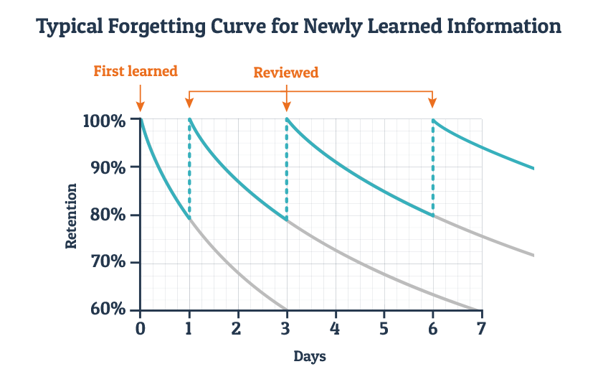
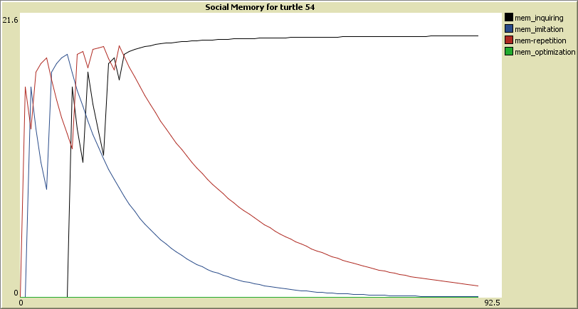
Modification 3: Memory of Agents
set r_inq r_inq - (dts * r_inq / s_inq )
Long term memory
This part of the equation can be used to compare between groups
Openness to experience vs closed to new experience, in other models

Slide 13
Analyses
Experiment 1: Neighborhood Size with Movement
Experiment 2: Neighborhoods with Flocking
Experiment 3: Variability in Utility Preferences

Slide 14
Experiment 1: Neighborhood Size + Speed

Slide 15
Experiment 1b: Neighborhood Size + Speed

Slide 16
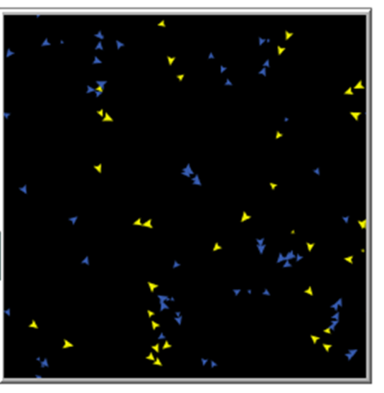
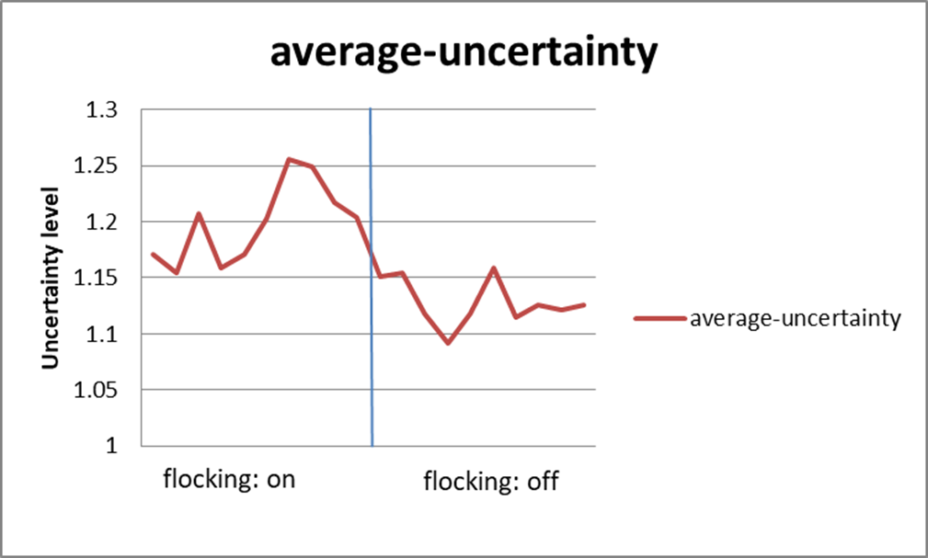
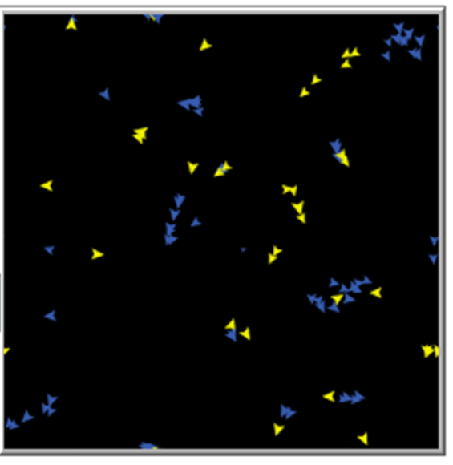
Experiment 2: Neighborhood+ Flocking

Slide 17
Experiment 3: Varying Utility Preferences ( )

Slide 18
Experiment 3: Varying Utility Preferences ( )

Slide 19
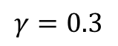
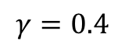
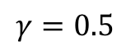
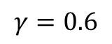
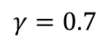
$$γ=0.3$$
$$γ=0.4$$
$$γ=0.5$$
$$γ=0.6$$
$$γ=0.7$$

Slide 20
Conclusions and Future Modifications
Even a simple model can generate unexpected results.
Add bias sampling of the information, memory, competition into the model.
Consider additional spatial modifications
Add other needs to the utility function
ex. environmental concerns, security

Slide 21
Thank you!

